Slide 1
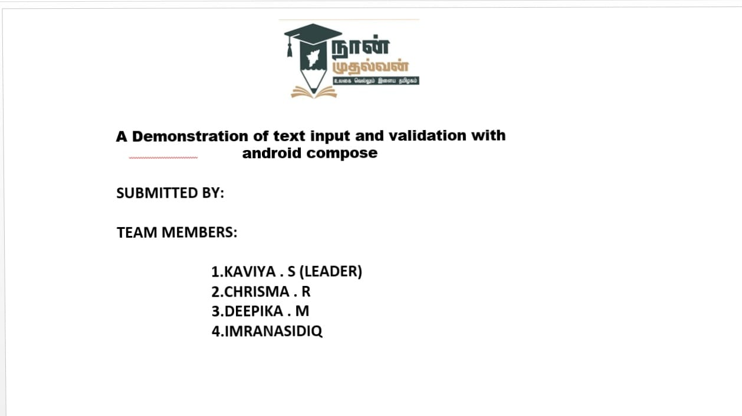

Slide 2

Enhancing User E perience: Demonstrating Te t Input and Validation in
Android Compose

Slide 3


Introduction to User E perience
In this presentation, we will explore enhancing user experience in Android applications.
Focusing on text input and validation
techniques, we aim to provide insights that will improve usability and efﬁciency for users. Let's delve into the importance of these elements in modern app development.

Slide 4


Understanding Te t Input
Text input is a crucial aspect of user interaction. It allows users to provide information and feedback. In Android Compose, we can create intuitive text ﬁelds that enhance user engagement. Properly designed text input ﬁelds lead to a more satisfying experience.

Slide 5


Types of Te t Fields
Android Compose offers various types of text ﬁelds such as Each serves different purposes and can be customized for speciﬁc use cases. Understanding these options is essential for creating a tailored user experience.

Slide 6


Implementing Te t Validation
Validation ensures that user input meets speciﬁc before submission. In Compose, we can implement validation logic to provide to users. This helps prevent errors and enhances overall user satisfaction by guiding them effectively.

Slide 7

User Feedback Mechanisms
Providing feedback is vital in the text input process. Use visual cues, such as error messages or success indicators, inform users of their input status.Effective feedback helps users feel conﬁdent in their interactions with theapplication.

Slide 8


Best Practices for U
When designing text input ﬁelds, consider accessibility, clarity, and consistency. Ensure that labels are clear and that inputs are easy to navigate. Following these best practices will create a more inclusive and effective user experience.

Slide 9

Case Study: Successful Implementation
Let's review a case study where effective text input and validation practices were implemented. This example showcases how these strategies improved user satisfaction and reduced input errors, leading to a more successful application overall.

Slide 10
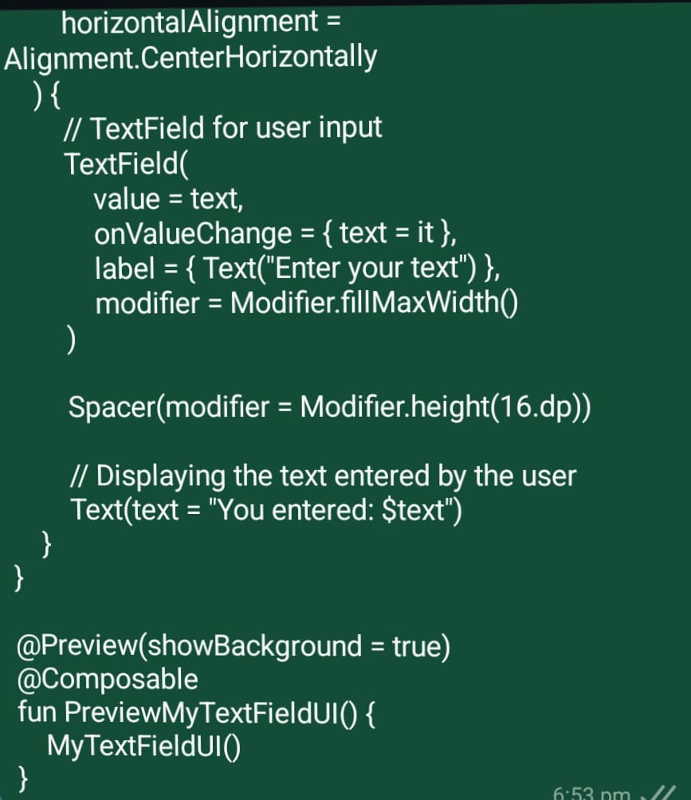
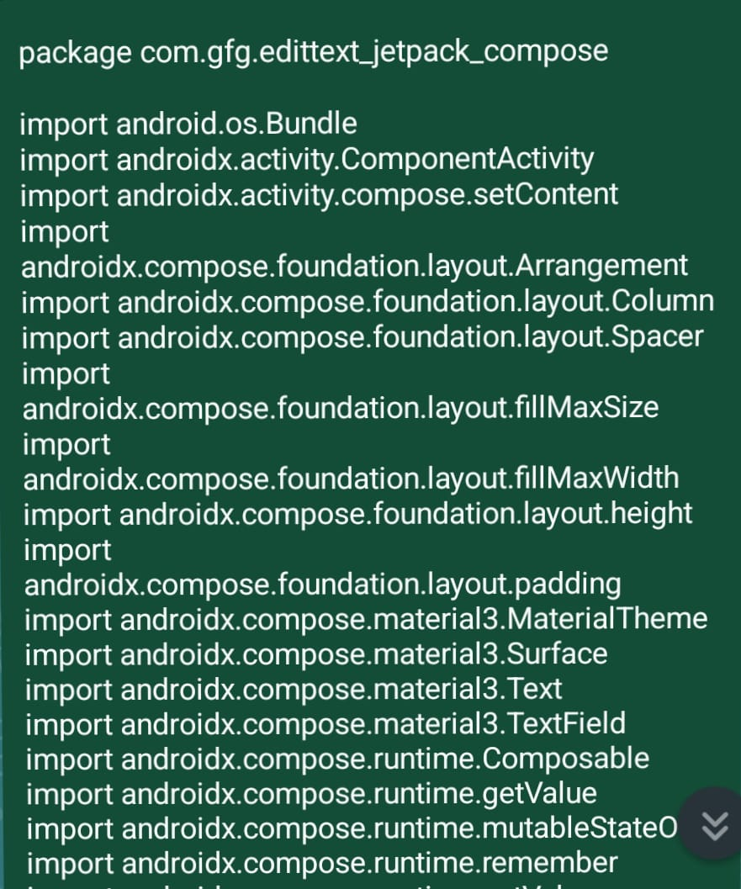
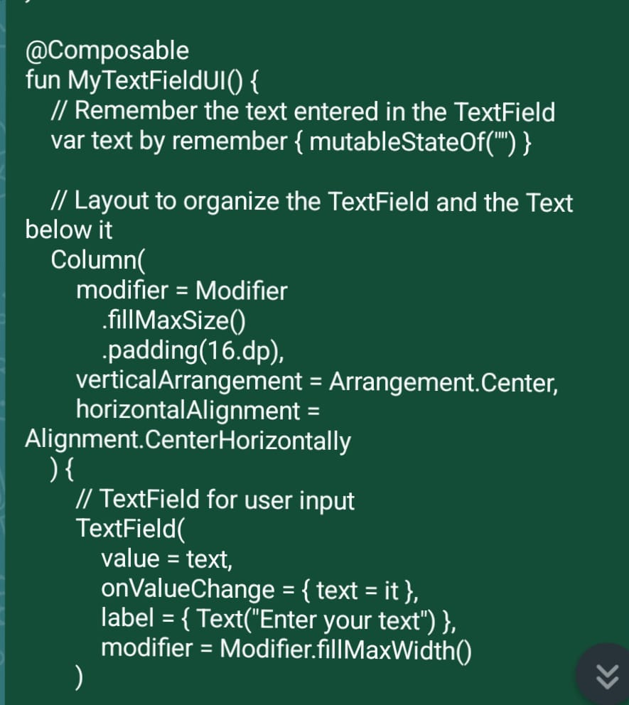

Slide 11
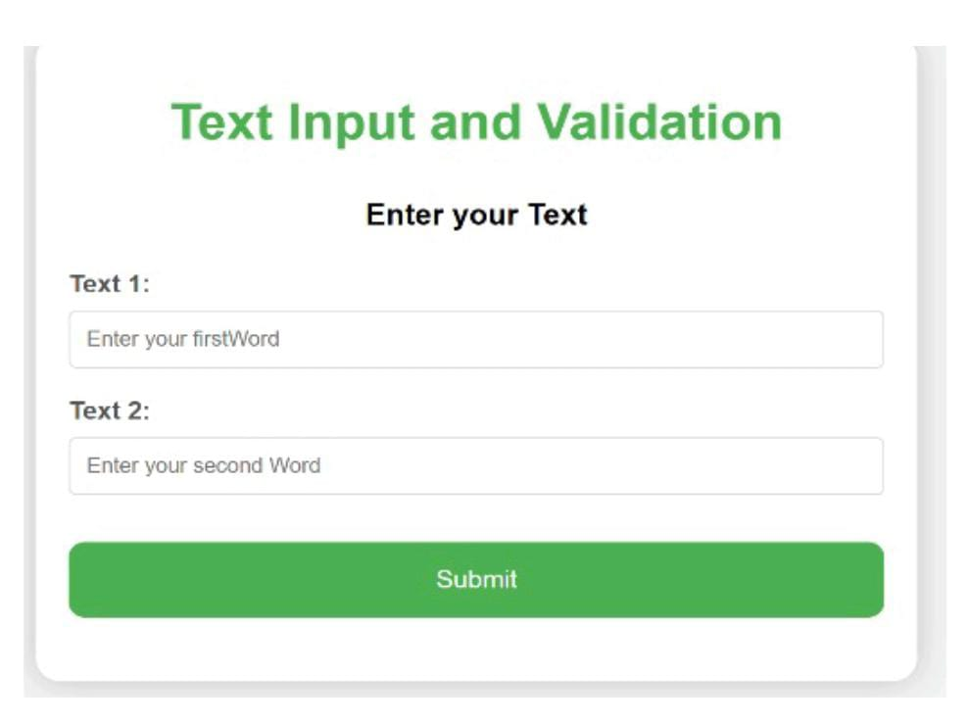

Slide 12
Conclusion and Key Takeaways
In conclusion, enhancing user experience through effective text input and validation in Android Compose is essential. By focusing on user needs, providing clear feedback, and adhering to best practices, we can signiﬁcantly improve the overall usability of our applications.

Slide 13
Thank you!

